Slide 1
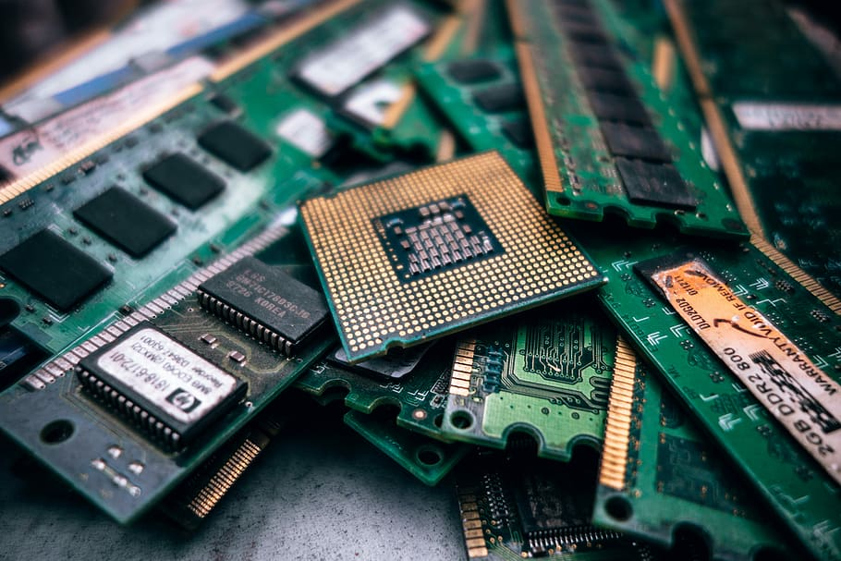
Benchmarking and Measuring of Performance-influencing Factors
Institute of Software Technology
Reliable Software Systems
Non-Functional Aspects in Software
Engineering 2019/2020
Philipp
Gruber
Notes:
Hello & Welcome [Name] [Topic] Let´s start with the Motivation

Slide 2

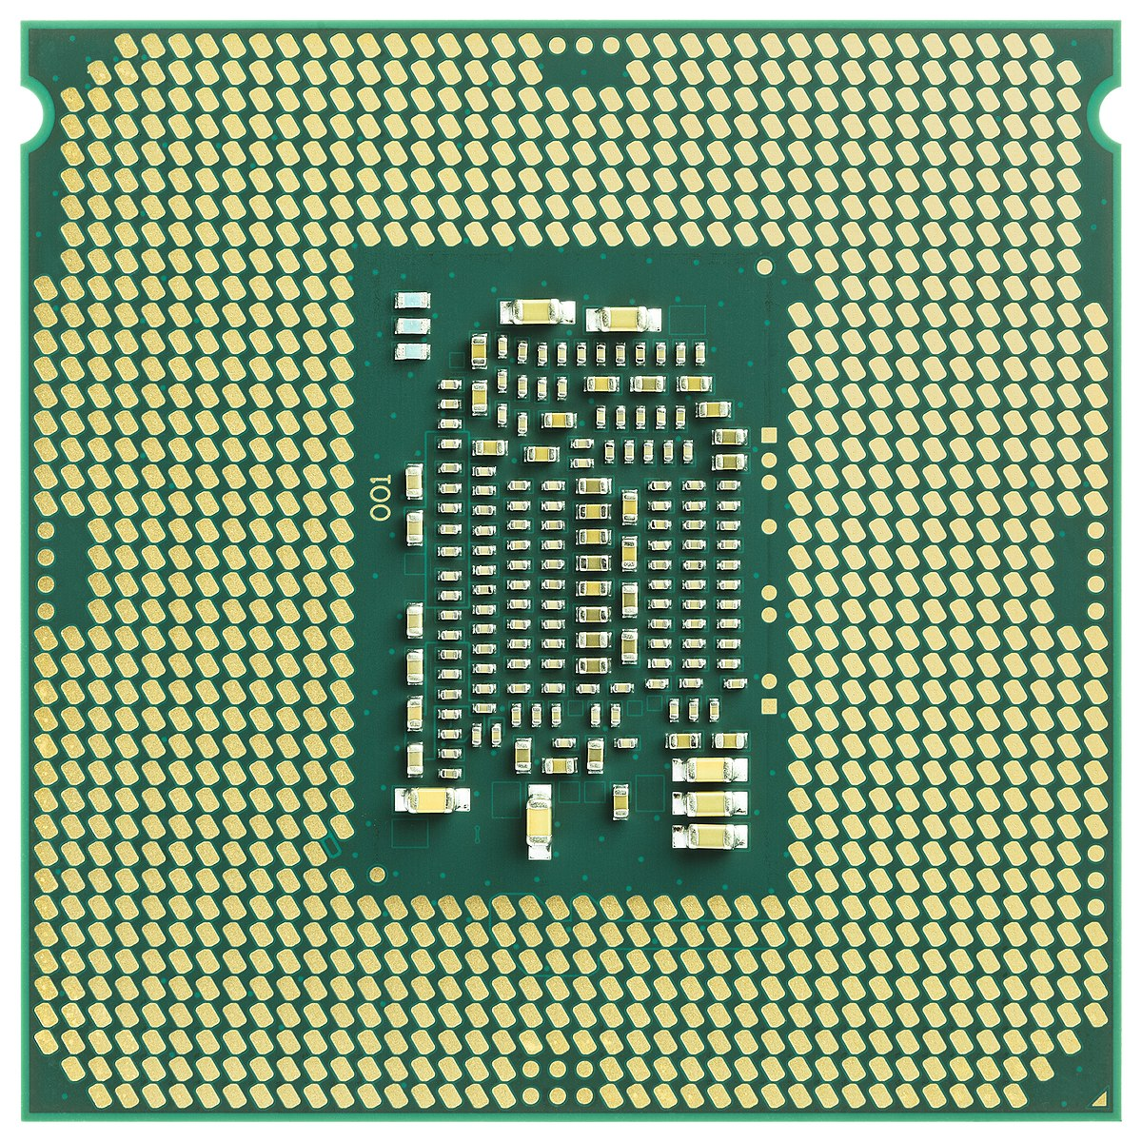
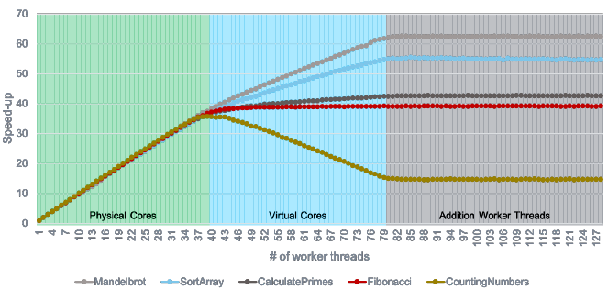
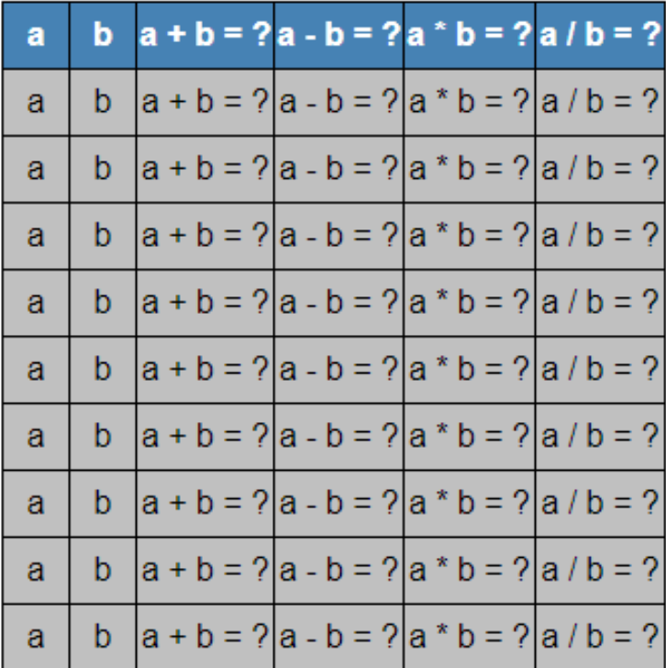



Motivation
Palladio
< 10 min
…
Test cases
6 Cores
Measurements
George
Test Engineer
Computer Scientist
Result
Notes:
Fur this purpose I introduce a Test Engineer named Lewis. Lewis as a T E deals with TestCases. Here illustrated in a Table. Each row represents tests Lews wants to execute as [Integrationtests] in a CI Pipeline. Because Lewis takes his job very serious he created a lot of test cases which caus the Pipeline to run up to 1 h until the developer get feedback, which makes the developer unhappy. To solve this conflict the agree to solve that with run them in parallel to gain time. He assumes a linear speed up. He confirms his assumption with a performance prediction of Palladio. Palladio predicts with 6 threads/cores that he can reduce the exuction time from 1 Hours to 10 min
He is confident that this holds true, but as it goes into production, duration is higer than 10 min, going to 30 min, which is non linear. Still much better, but he missed his target → problematic
This problem for performance prediction in a multicore context is known, and computer scientiest are trying to solve that

Slide 3

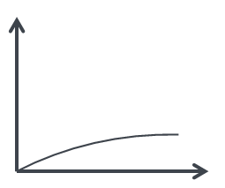
Motivation
Palladio
< 10 min
…
Test cases
6 Cores
Measurements
George
Test Engineer
Computer Scientist
Result
Notes:
For example with reference curves from [Frank et al] to improve the accurarcy, that it predicts that non linear speed up
What are refrence curves? Take a more detailed look

Slide 4

Motivation
Generalizable?
Physical Cores
Virtual Cores
Addition Worker Threads
Notes:
The reference curves measured by Frank et Al, contain five different applications. All five have a different speed up behaviour.
The speedup behaviour can be seperated into three stages, physical („nearly“ linear), virtual (different speed up, even negative) and add worker threads which did not change anything
The idea is now, if we knows for ex. That his test trigger mostly CPU intensive calculation as calc Prime/fibo, one would expect the same speedup behaviour. That could improve the accurarcy of the performance predictions, if those curves are generalizeable

Slide 5
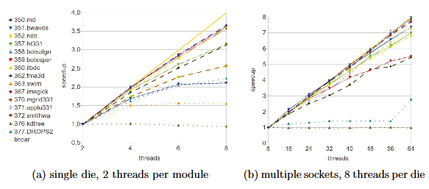
Approach
RAM
SPEC Benchmark
synthetic
Non-synthetic
Compare
Problem
Solution
Result
RQ1 → Differences?
RQ2 → Generalizable?
H1 → Yes
H2 → Partly
Notes:
This is problem we deal with in this work, because the applications of the seen speedup behaviour were created in a „synthetic“ way. Which raises concerns aboult the Generalizability of those curves.
Our solution to address this concerns would be to use other applications that does not have this limitation. Applications from the SPEC Benchmark, because of their nature, those are realistic and representative „non-snythetic“ use cases
In the end we want to compare the results of our work with them of Frank et al and answer two RQ, first can we spot differences, and in addition if both have similarities that allow to generealize from
Our hypothesis is that there is a difference in the behaviour but still some parts that both have in common

Slide 6



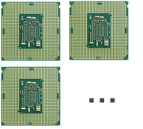


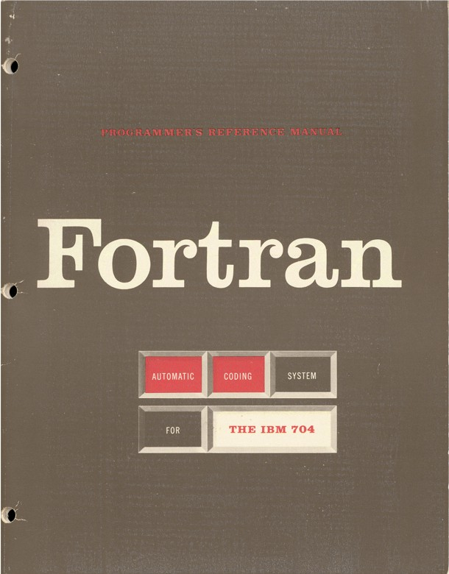




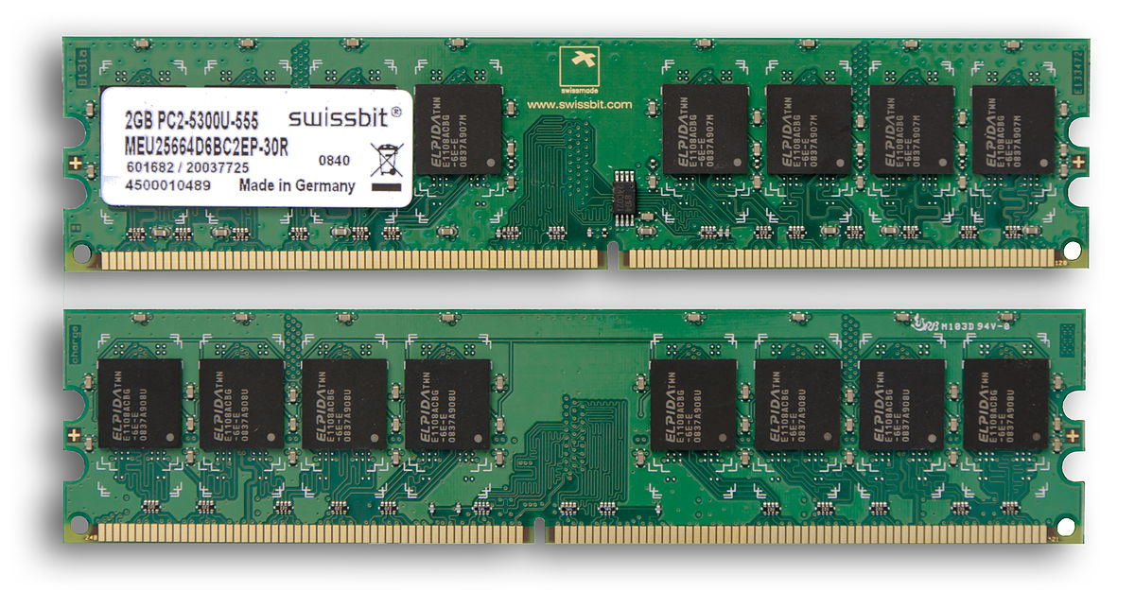

Solution
SPEC OMP®2012
40 vs.12
80 vs.24
90 | 30
threads
Up to 3 runs
Experiment
vs.
Non-optimized
Demand type
Portability
Execution time
Notes:
To do that we we conducted a experiment. We chose one of the SPEC Benchmarks for many core systems. SPEC OMP 2012, that consists of 14 applications written in fortran, c and c++. Those programs were parallized by
The parallelization framework OpenMP → OMP
The first thing we had to solve was to get them building and running. That was not easy because we have to deal with a sparse docu and a long execution time.
After we figured that out, we run the benchmark on two different machines. The bigger one had 40 cores, the smaller 12, with hyper-threading the number doubles. It is typicall to run those applications three time and take the mean, we had to adapt to that because of the long execution time, and only executed them three times, if the results were suspicious.
One point to our set up, we used the auto or base setting, meaning we did not thrive for the peak performance by optimizing.
And regarding if a application is more memory or CPU demanding, we tracked the degree of memory utilization in percent, which is a machine relative/dependent
In the end we expect such reference curves as shown from frank et al

Slide 7
Preliminary Results
Notes:
Now to the preliminary results, they are preliminary, because of the high execution time the experiments are still running, now running nearly two months
Therefore only the results of the smaller machine are ready to be presented

Slide 8

Result
Notes:
„steeper increase“„flat increase“ staying constant
Four groups, those which are strict above, those who are below, the three (botsspar, nab, kdtree) that do not really fit in either of them
Smithwa (md, ildbc) behave just odd
Mem utilazation seems to be have a correlation where a app roughly is in the plot, at least when we arrive at the high thread numbers
But this is only a correlation no causation

Slide 9
Result
Physical Cores
Virtual Cores
Addition Worker
Threads
Notes:
„steeper increase“„flat increase“ staying constant
Four groups, those which are strict above, those who are below, the three (botsspar, nab, kdtree) that do not really fit in either of them
Smithwa (md, ildbc) behave just odd
Mem utilazation seems to be have a correlation where a app roughly is in the plot, at least when we arrive at the high thread numbers
But this is only a correlation no causation

Slide 10
Result
Notes:
„steeper increase“„flat increase“ staying constant
Four groups, those which are strict above, those who are below, the three (botsspar, nab, kdtree) that do not really fit in either of them
Smithwa (md, ildbc) behave just odd
Mem utilazation seems to be have a correlation where a app roughly is in the plot, at least when we arrive at the high thread numbers
But this is only a correlation no causation

Slide 11
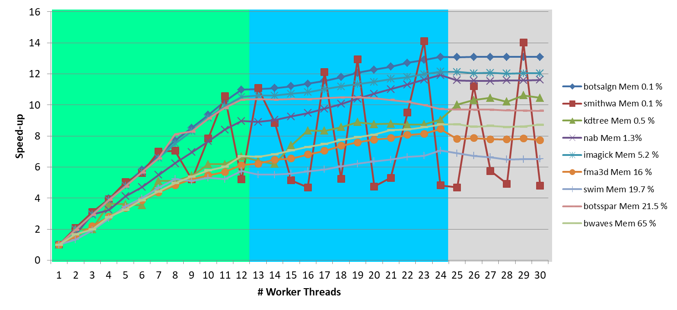

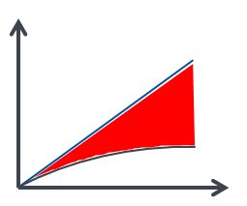
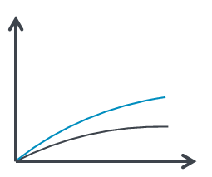


Summary
RQ1 → Differences? RQ2 → Generalizable?
Lessons learned:
- Stages
- More noise
- Non-linear
- Further growth
- Memory %
- Variation
Notes:
Lessons learned regarding our research questions, frist did we spot difference, or the other way round, what is similar.
The rough structure of the three stages is the same, meaning the strongest increase of speed up in the first, mostly further in the second and the smallest if any in the third
But obvious, also if we look a the speedup divided by the core number, we observe for our realtistic more noise and variation (not only in simthwa) and less smooth and uniform curves.
The group with a clear nin linear speed up in stage 1, stage 2 we have no app that can match the gains form array/mandelbrot,butsome of our apps have further increase by adding more threads over the hyperthreading limit
So to answer the question, can we generealize? The rough stage behaviour yes, the rest depends, it seems based on our mem utilzation metric that the apps with low allocation, perform as the CPU intensive fibo/prime, but our metric can be misleading in that regard. In addtion it seems there is a missing representatve in frank et al for a memory bandwith bound app, as maybe all our group 2 apps seem to be.
To figure that out would be the job of future work(how can we classify the type of resource demand of our tasks)

Slide 12





Threats to the validity
Threats:
Future Work:
Memory behavior
Only one benchmark
Only two machines
Non-optimized
Low program knowledge
Effect of optimizing
More machines
More Benchmarks
Detailed low-level
performance metrics

Slide 13
Back up

Slide 14
Copyright
Title picture from https://www.piqsels.com/sv/public-domain-photo-sxmib
People from https://www.flaticon.com/packs/avatar-10 (monkik)
Cliparts from http://office.microsoft.com/de-de/images/
Palladio logo from https://sdqweb.ipd.kit.edu/wiki/File:Pcm-logo-stilisiert.png
SPEC Plot from [Müller12]
Plot Slide 3 from [Frank19]
Rest made by myself

Slide 15



Solution – Benchmark?
Competition
SPEC Performance Benchmarks
vs.
Realistic tasks
Notes:
First let´s answer the question what a benchmark is. Assume we have a competition between two hardware systems, and we want to decide which is better, at least in the perspective which can perfom better regarding the execution time. ? To answer that question benchmarks as the SPEC were designed.
They use a bunch of applications which were created to solve scientific tasks/pronblems. Because they came from the real world, they are realistic tasks and give better answers than some constructed application. In the end we would get an overall value for each machine to determine which machine performed on those benchmark taks. We were not interested to answer that question, but the realistic tasks are exactly what we need to get more realistic reference curves.

Slide 16
Physical Cores
Virtual Cores
Addition Worker Threads

Slide 19
References
[Frank19] – Frank, M., Becker, S., Kaplan, A., & Koziolek, A. - Performance-influencing Factors for Parallel and Algorithmic Problems in Multicore Environments
[Müller12] – M. S. Müller, J. Baron, W. C. Brantley, H. Feng, D. Hackenberg, R. Henschel, G. Jost, D. Molka, C. Parrott, J. Robichaux, P. Shelepugin, G. M. van Waveren, B. Whitney, and K. Kumaran. - SPEC OMP2012 - an application benchmark suite for parallel systems using openmp.

